Slide 1

Team Report for Excelerate Dashboard
Empowering Learners Through Data-Driven Insights

Slide 2
Introduction
Excelerate is a global platform dedicated to empowering learners, institutions, and employers through virtual training, scholarships, masterclasses, power skill courses, global internships, and career development programs. Our dashboard provides actionable insights into platform engagement, geographic reach, and skill development.

Slide 3
Team Members and Roles
[Abayomi Ogundeji/David Ayodele]: Project Manager - Guidance and data processing
[Barnabas Amankhu]: Visualization design
[Juwaira Abdulaziz]: Project Lead - Accountability and interactivity implementation
[Team]: Insights analysis and report writing

Slide 4
Challenges and Solutions
Challenges:
- Data quality: Missing data and inconsistencies, spelling errors
- Performance: Large data sets caused delays in rendering interactive visuals
- Clarity: Balancing simplicity and depth in heatmaps to avoid clutter
Solutions:
- Standardized formats and removed duplicates.
- Aggregated data for performance optimization
- Simplified designs

Slide 5
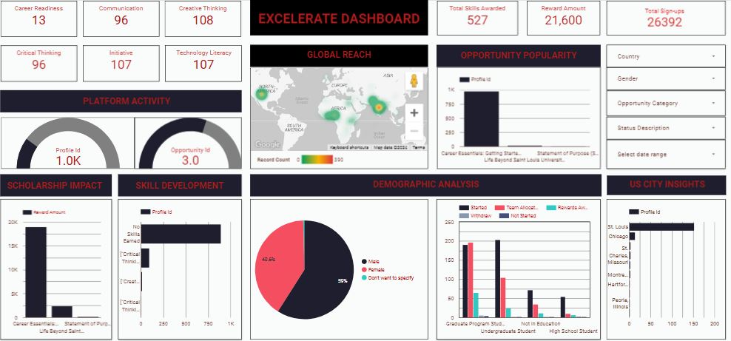
This dashboard shows:
- Platform Activity: User engagement metrics
- Global Reach: Heatmap of user sign-ups
- Opportunity Popularity: Bar chart of popular programs
- Scholarship Impact: Analysis of scholarship amounts
- Skill Development: Trends in skill acquisition
- Demographic Analysis: Gender and education breakdown
- US City Insights: City-level engagement heatmap

Slide 6
Key Decisions and Design Choices
- Collaborative layout prioritizing key metrics
- Heatmaps for geographic data
- Bar and pie charts for comparisons and demographics
- Interactivity with filters for better user engagement
- Consistent color scheme aligned with Excelerate branding

Slide 7
Insights Derived
- Platform Engagement: 1,000 profiles created, 3 opportunities per profile
- Global Reach: Strong participation in North America, Asia, and Africa
- Popularity: 'Career Essentials' is the top program
- Scholarship Impact: $21,600 awarded
- Demographics: 59% male, mostly undergraduates

Slide 8
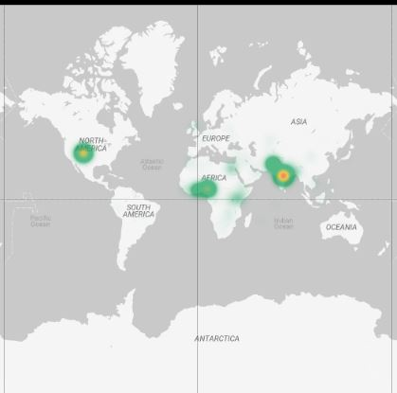
Global Reach Heatmap
This heatmap shows the countries Users signed up for one opportunity or the other. These are predominantly in North America, Asia, and Africa.

Slide 9
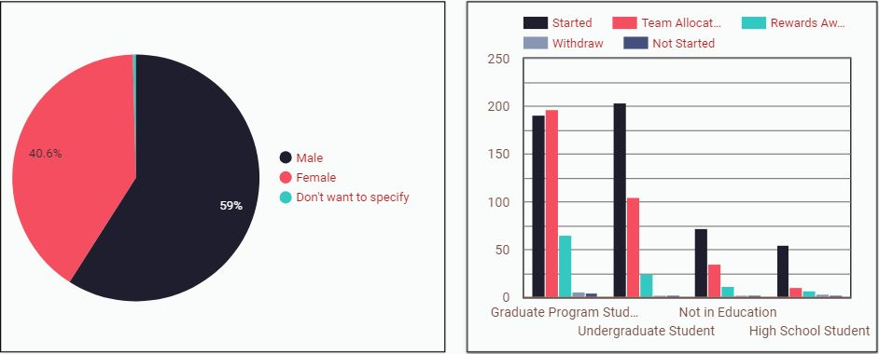
Demographic Analysis
59% of users are male, and the majority are undergraduate students

Slide 10

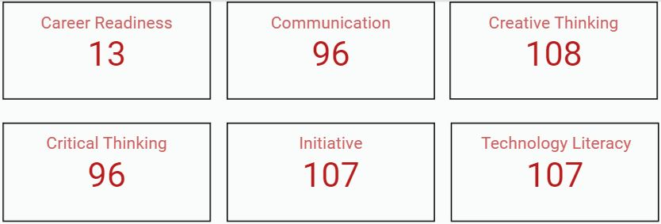
Platform Activity
At least 1,000 profiles, with 3 opportunities per user on average.
Skills Awarded
Communication, critical thinking, and technology literacy are the most gained skills. The highest awarded was in Creative thinking, with Career readiness being the lowest.

Slide 11
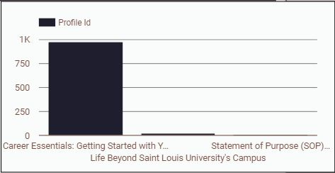
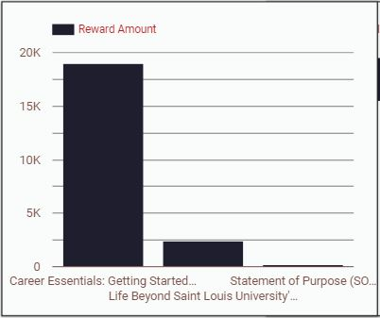
Opportunity popularity
Career Essentials is the most popular program, indicating high interest in career readiness. This is followed by Life Beyond St. Louis and Statement of Purpose programs.
Over $21,600 in scholarships was awarded, with significant allocation to Career Essentials ($19000).

Slide 12
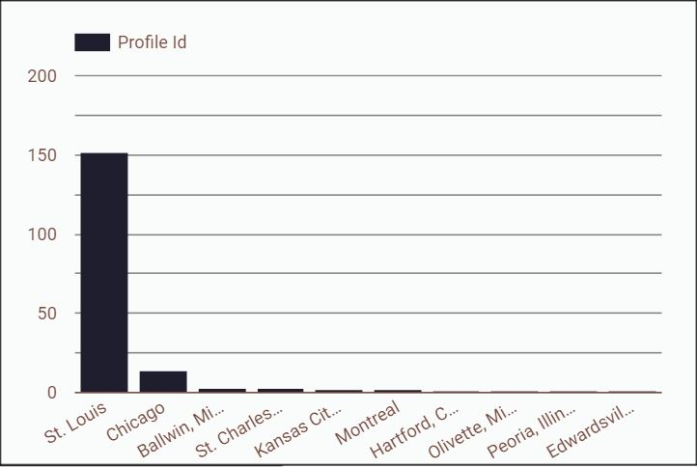
US City Impact
The City of St. Louis had the highest number of participants who signed up for an opportunity, followed with Chicago, Missouri, Montreal and Connecticut

Slide 13
Recommendations
- Enhance global outreach with multilingual support
- Promote and refine opportunities
- Target female learners with mentorship programs
- Bridge skill gaps and align with market demands
- Expand scholarships and monitor impact
- Use geo-targeted campaigns and success stories use in St. Louis to expand Excelerate’s reach to other cities across the world.

Slide 14
Conclusion
By implementing these strategies, Excelerate can expand its reach, optimize engagement, and further its mission of empowering learners globally. These insights, developed through teamwork, will drive meaningful growth and success.

